Slide 1

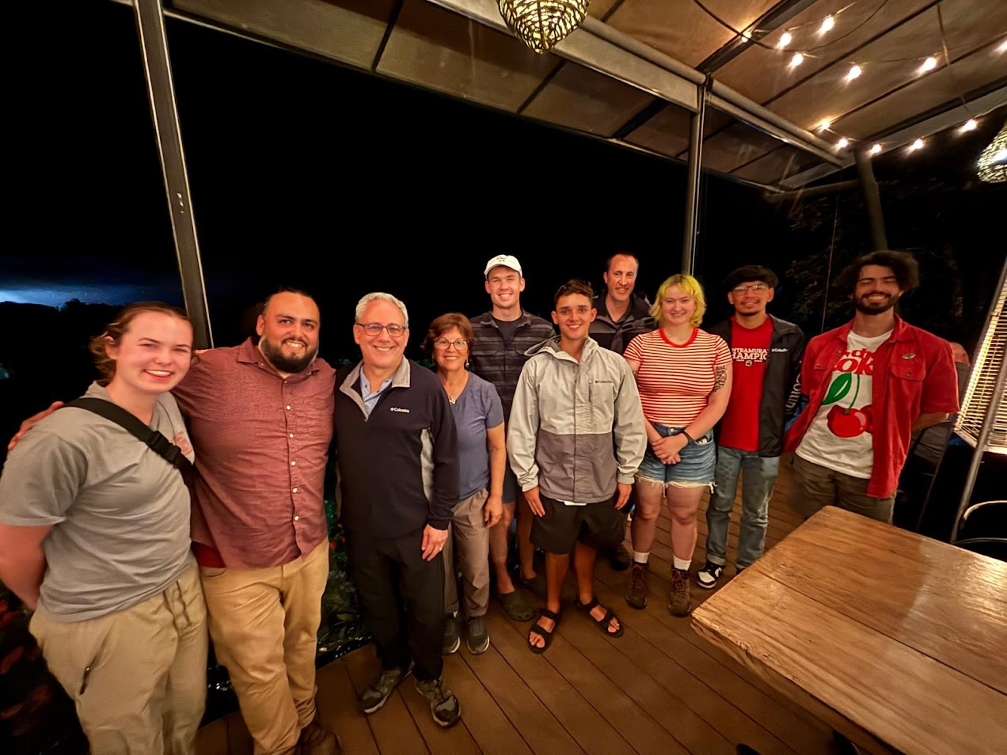





US-Costa Rica Collaboration to Quantify the Holistic Benefits of Resource Recovery in Small-Scale Communities

Slide 2
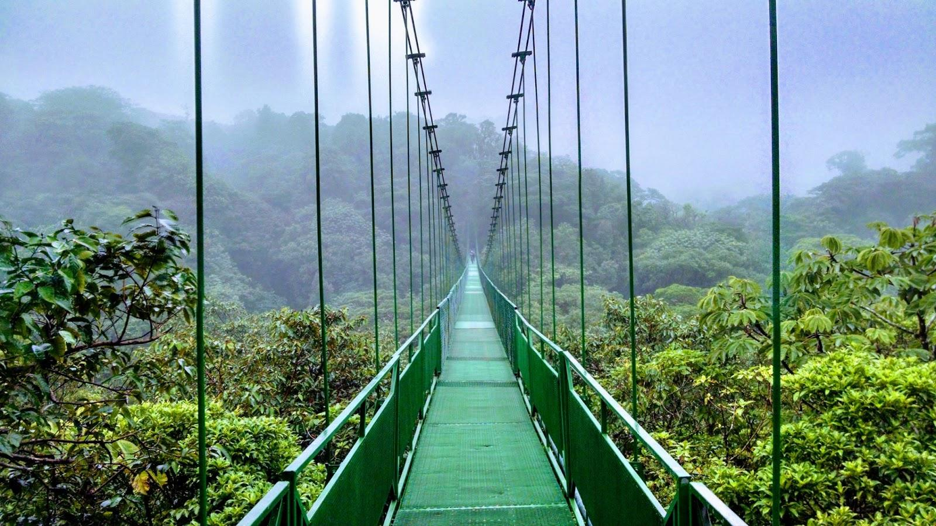
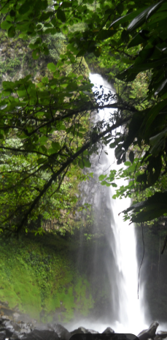
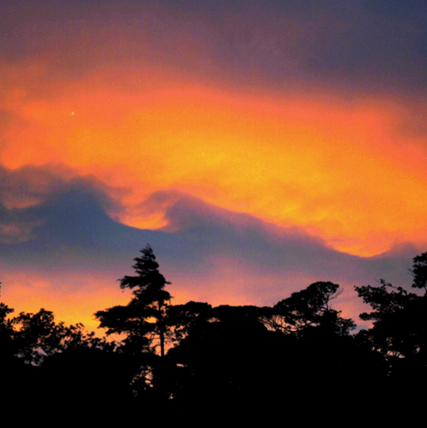
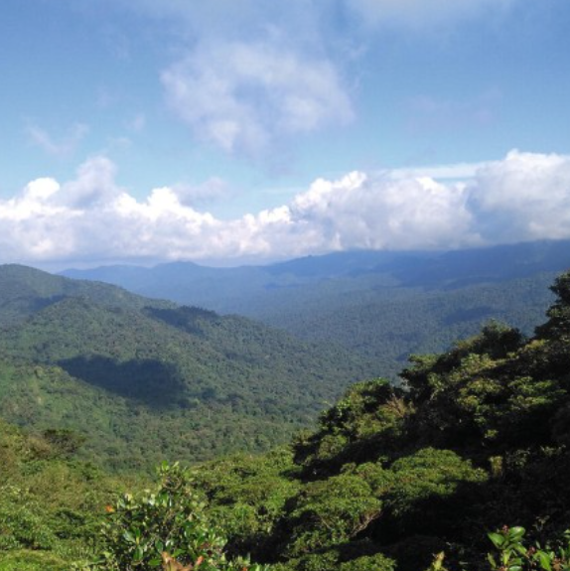
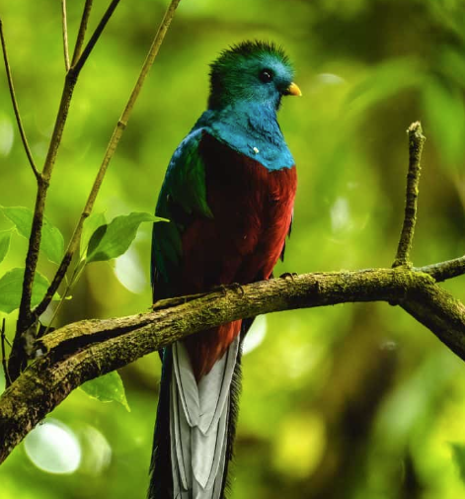

Slide 3
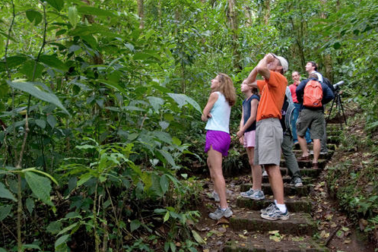
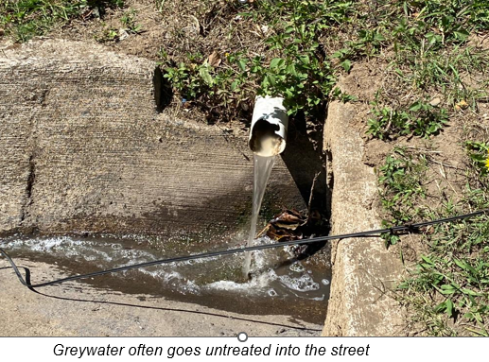
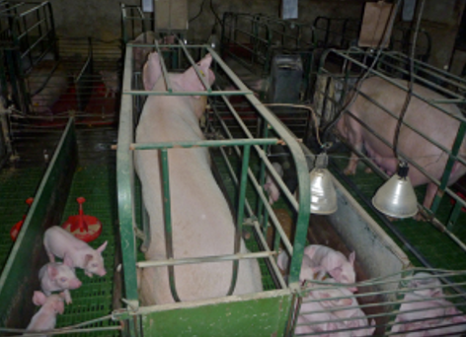

Slide 4
Develop students’ interdisciplinary research skills
Collaborate with local communities
Enhance cultural exchange/learning
Address pressing issues of water and sanitation in Monteverde, Costa Rica

Slide 5
All expenses paid (Airfare, homestay accommodations, food) plus $530 weekly stipend
Six weeks in country (June 15th-July 26th)
Opportunity for publications/presentations
Open to anthropology and engineering students (6 total)

Slide 6
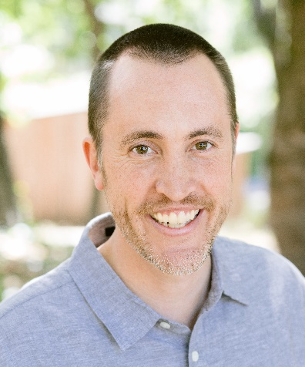
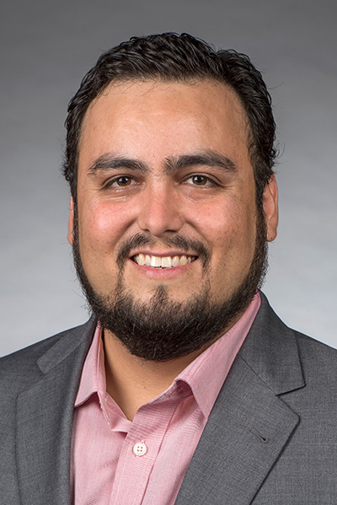
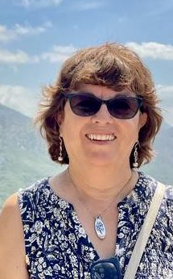
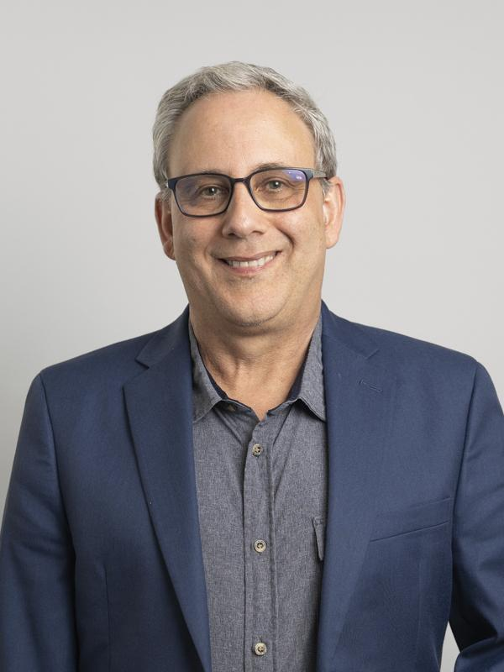
U.S. Faculty – Principal Investigators
Dr. Kevin Orner
Department of Civil and Environmental Engineering
West Virginia University
Dr. Pablo K. Cornejo
Department of Civil Engineering
California State University, Chico
Dr. Nancy Romero-Daza
Department of Anthropology
University of South Florida
Dr. David Himmelgreen
Department of Anthropology
University of South Florida

Slide 7
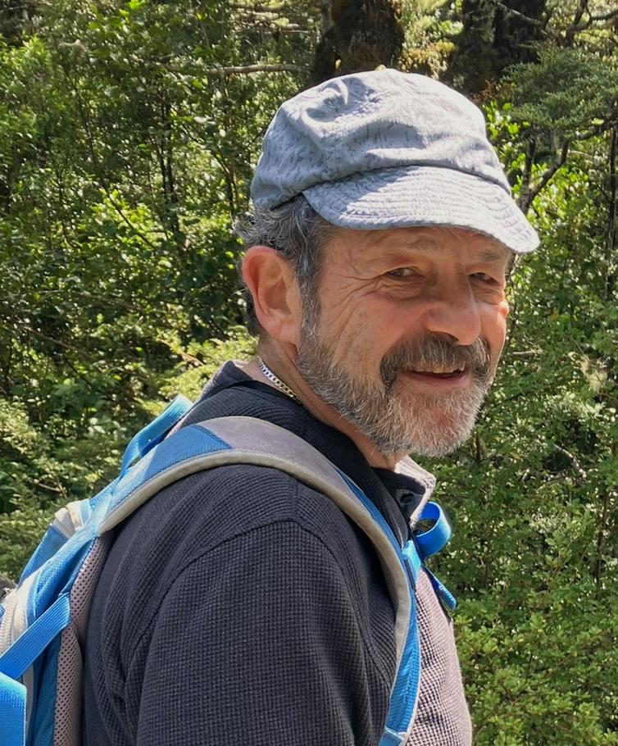
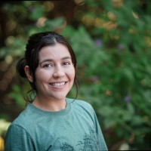
U.S. Faculty – Evaluator
Monteverde Institute
Dr. Allan Feldman
Professor Emeritus
University of South Florida
Alexandra Paniagua
Academic Director

Slide 8
Purpose
Info meeting to:
Introduce NSF-IRES goals and objectives
Share our experiences from Year 1 and Year 2
Answer your questions
Encourage you to apply!
Hanging bridge in the Monteverde Cloud Forest

Slide 9
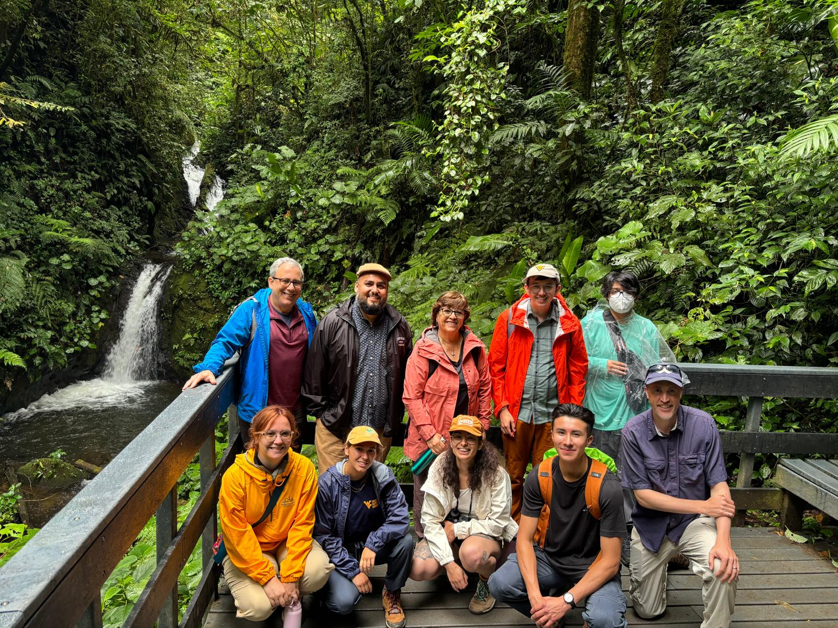
Icebreaker
Name
Where you call home
Why you are interested in this international research experience
Questions you have about the program
Notes:
This can take a lot of time if there are more than a few interested students. You may want to consider setting up multiple rooms if there are more than 10 or so participants. The PIs can go into the different rooms to moderate the discussion.

Slide 10
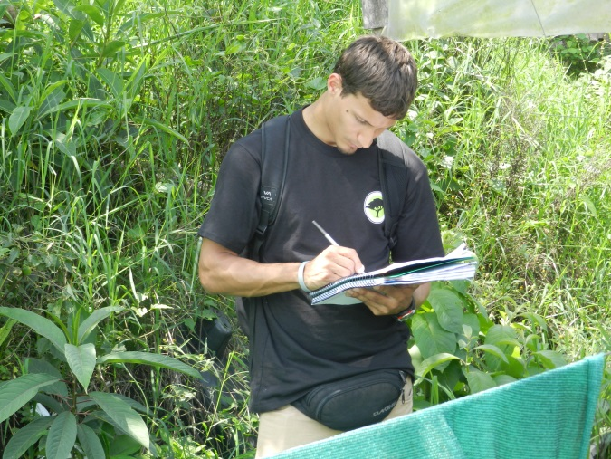
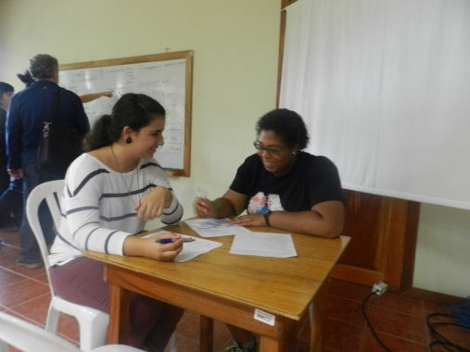
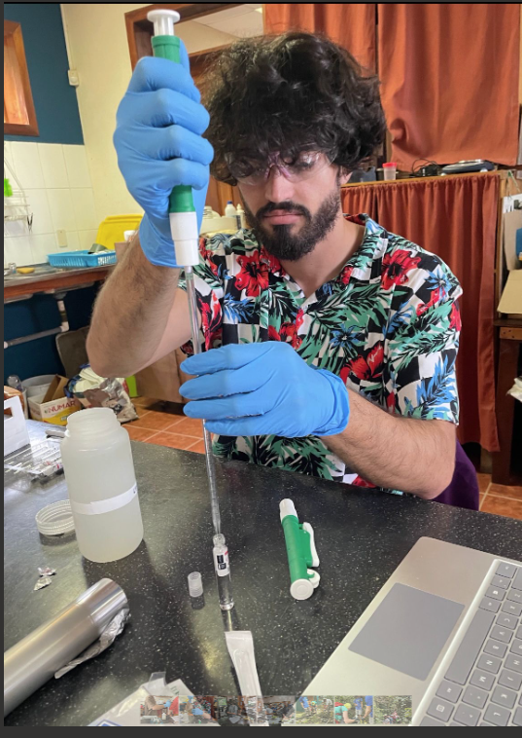
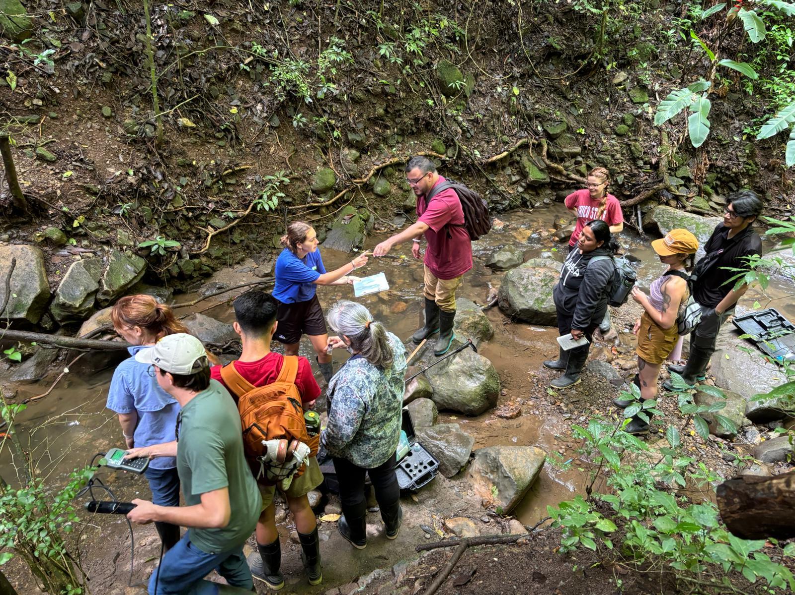
Interdisciplinary Research: Engineering and Anthropology

Slide 11
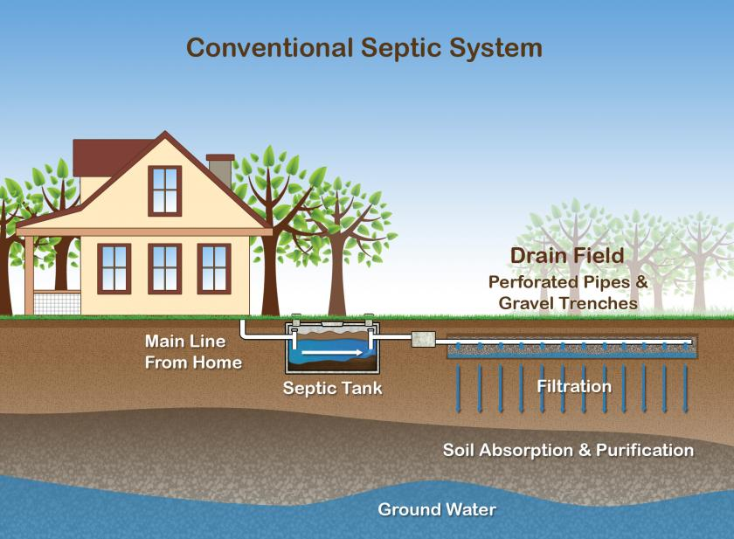
In Costa Rica…
75.4% of its five million residents use septic tanks¹
66% of the septic tank sludge is not treated before disposal
Many septic systems are not properly treating wastewater
National goal to have wastewater treatment for²:
100% of urban areas by 2030
100% of rural areas by 2050
¹Mora Alvarado, D. y Portuguez B., C. F. (2019). Agua para consumo humano por provincias y saneamiento por regiones manejados en forma segura en zonas urbanas y rurales de Costa Rica al 2018. San José, Costa Rica.
²Acueductos y Alcantarillados (AyA), Ministerio de Ambiente y Energía (MINAE) y Ministe- rio de Salud (MS). (2016). Política Nacional de Saneamiento en Aguas Residuales 2016-2045. San José.

Slide 12
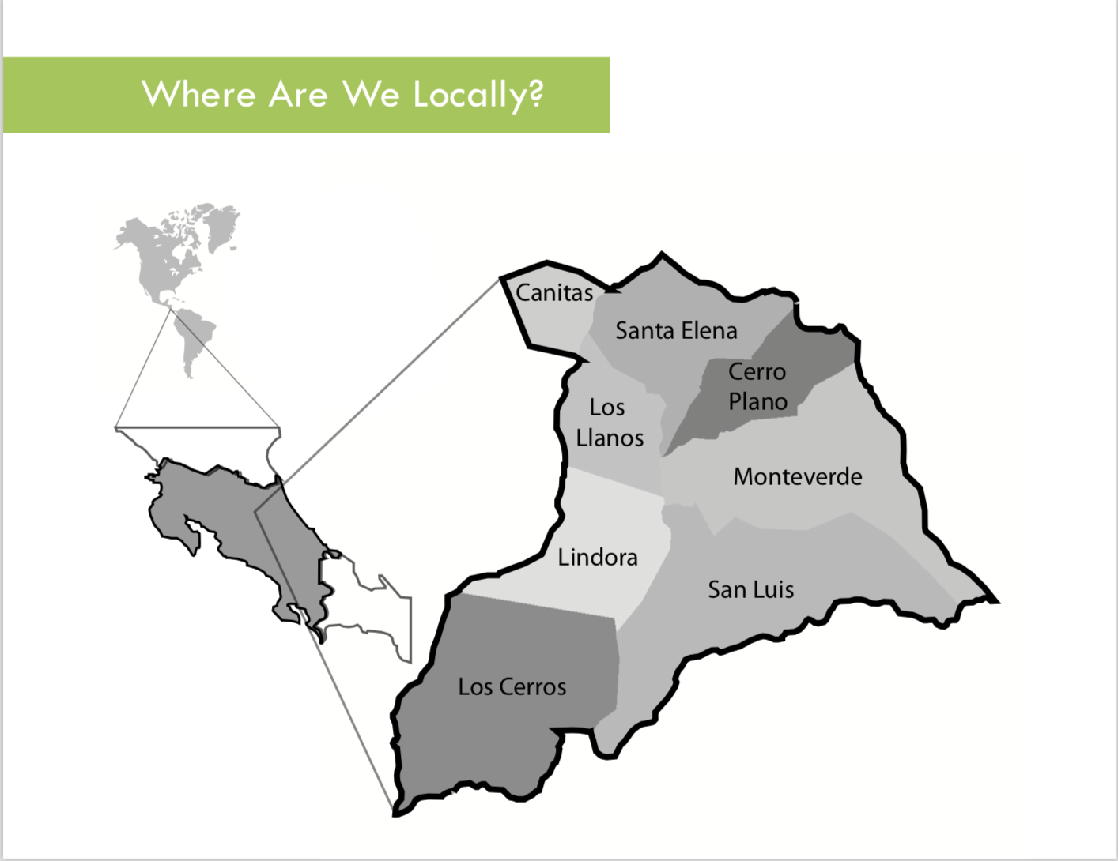
Sustainable Futures (2012)

Slide 13
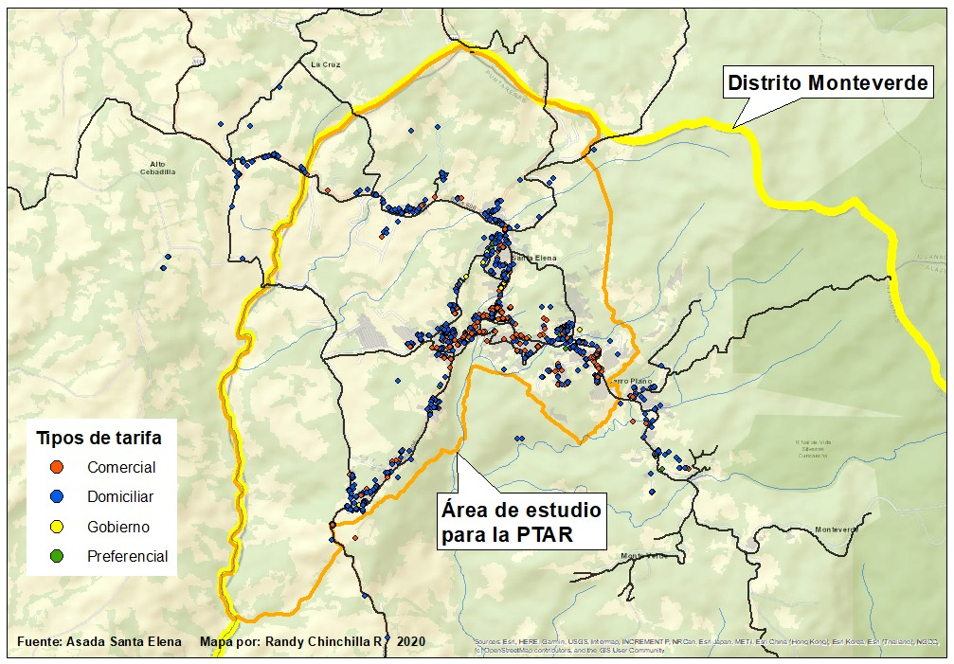
Monteverde Region
Characteristics of critical area¹:
Urban and semi-rural
Tourist destination
~6,500 residents
~250,000 visitors/year
Average wastewater flow: 1,184 m³/day
Problems identified:
Challenges with septic systems
Limited greywater treatment
Aesthetic concerns
Public health risks
Study area in Monteverde
¹Sanchez Vega, C. y Vindas Ruiz, R. (2022). Analisis socioeconomico y propuesta para la implementacion del Sistema de tratamiento de las aguas residuals de la ASADA de Santa Elena de Monteverde. Unversidad Tecnica Nacional, Alajuela, Costa Rica.
²CEHIREH (2017). Enfoques Estrategicos del Plan Municipal para la Gestion Integral de Aguas Residuales en el Districto Municipal de Monteverde. Comision especial para la gestion integral de recursos hidricos de Monteverde. Monteverde, Costa Rica

Slide 14
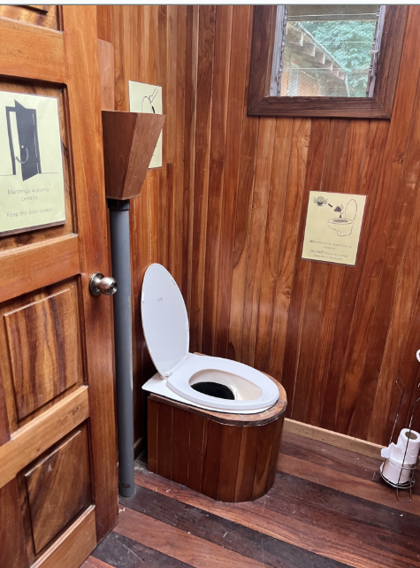
Y1 (2024): “Black Water”
Septic tanks and Composting toilets

Slide 15
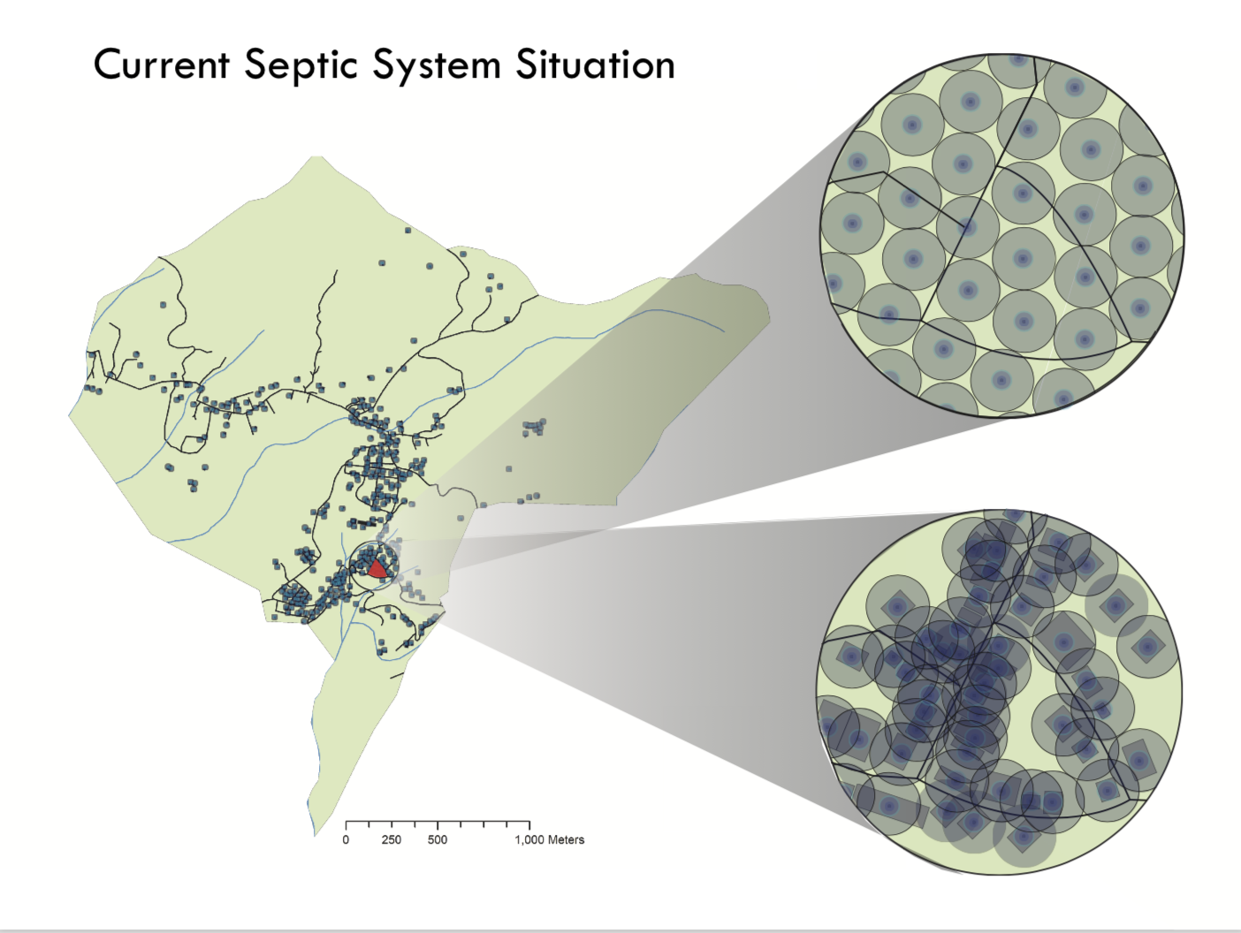
Sustainable Futures (2012)

Slide 16
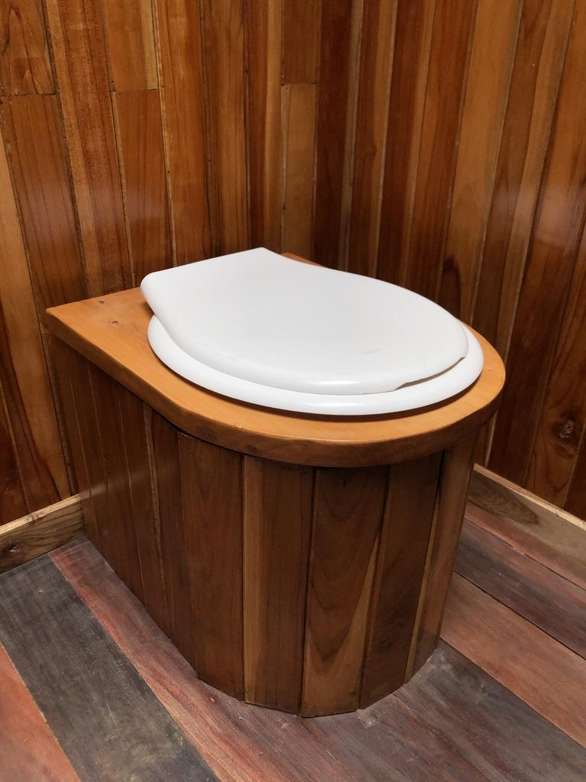
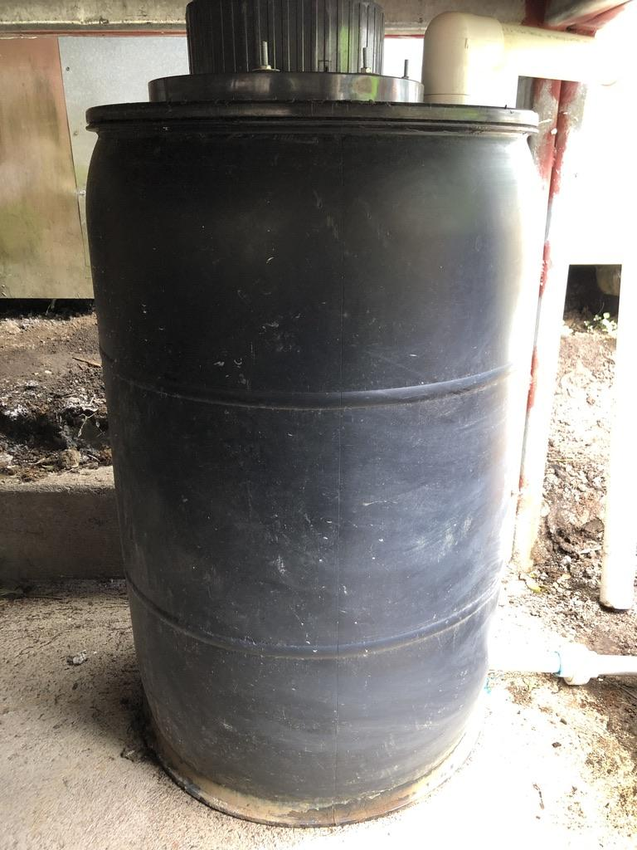
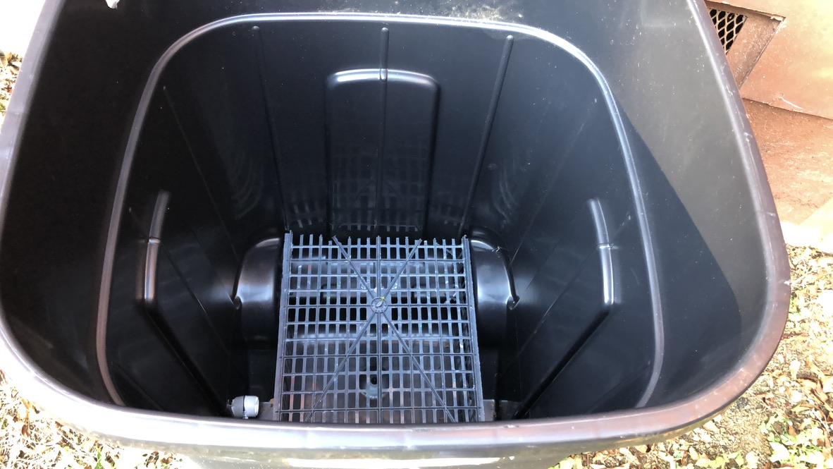
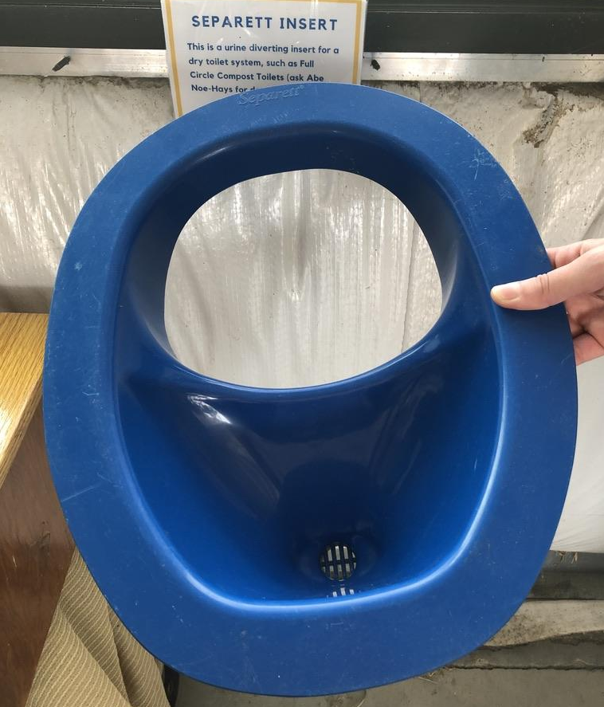
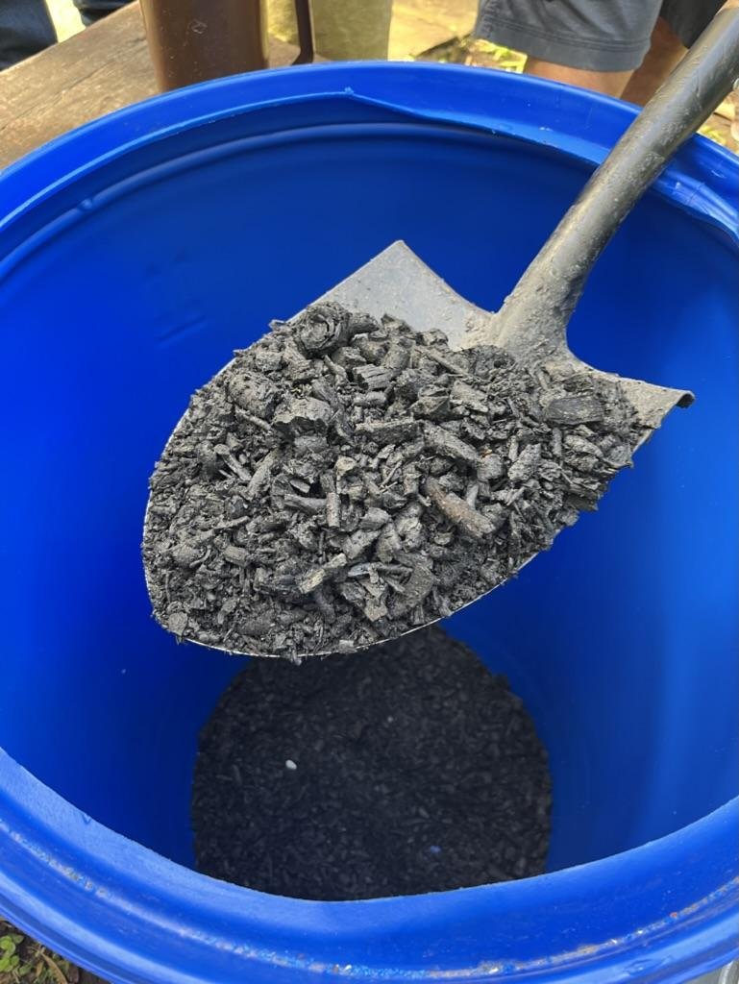
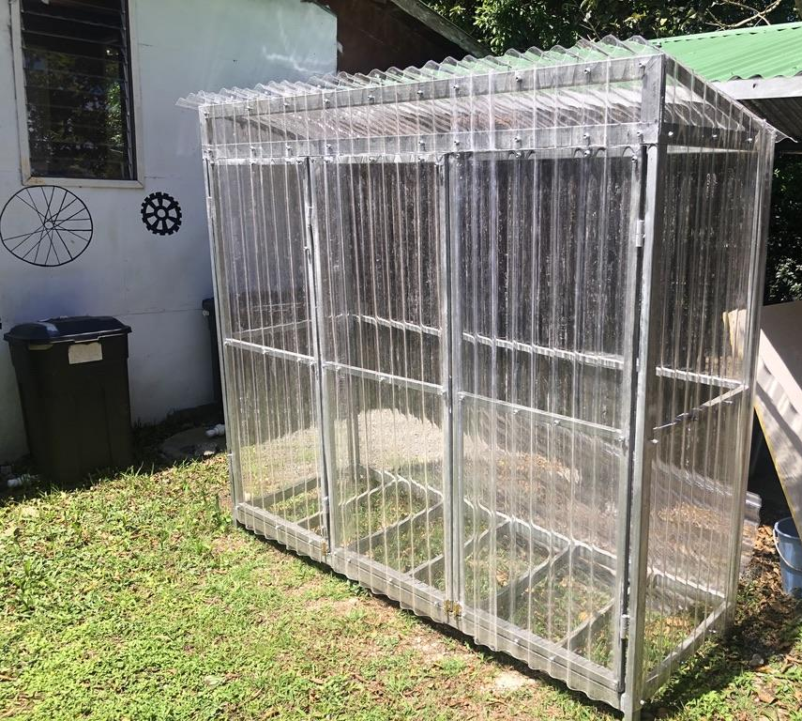
Composting Toilets
Conserve water
Reduce carbon footprint
Recycle nutrients
Public perception issues
Notes:
28% of water in a typical home is used to flush toilets
3% of carbon footprint in Monteverde from sanitation sector – septic tanks and fertilizer usage
Factors impacting pathogen removal = temperature, moisture content, storage time, pH

Slide 17
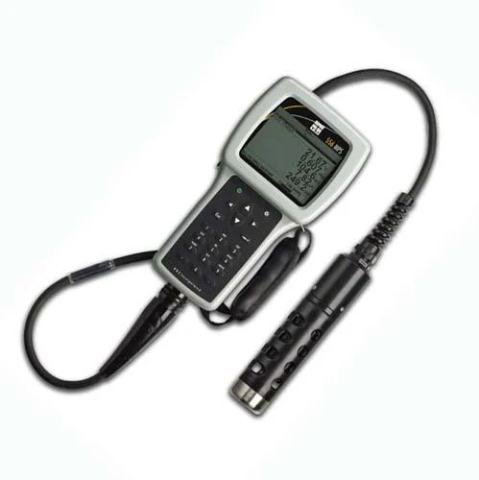

Methods and Data Collection
Gathered field data
Analyzed samples
Sent samples for analysis

Slide 18
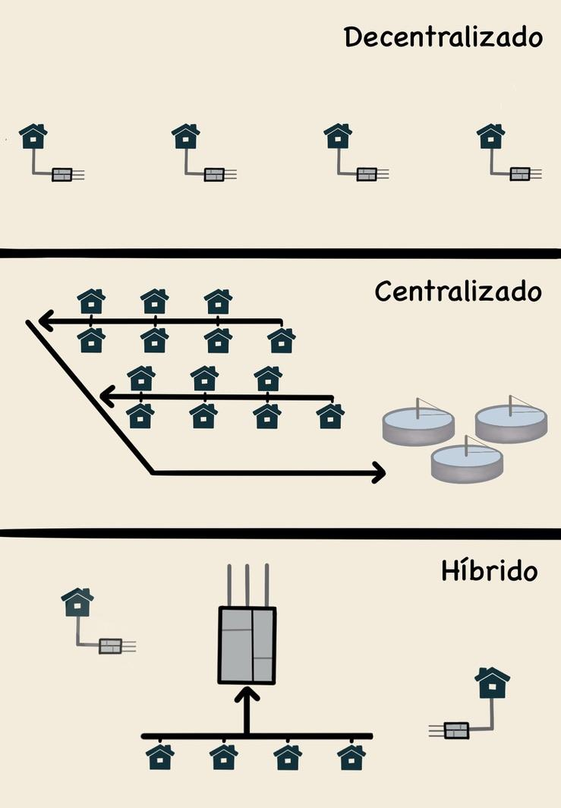
Formal Interviews (N=32)
Practices and perceptions of wastewater treatment
Average Duration
46 minutes

Slide 19
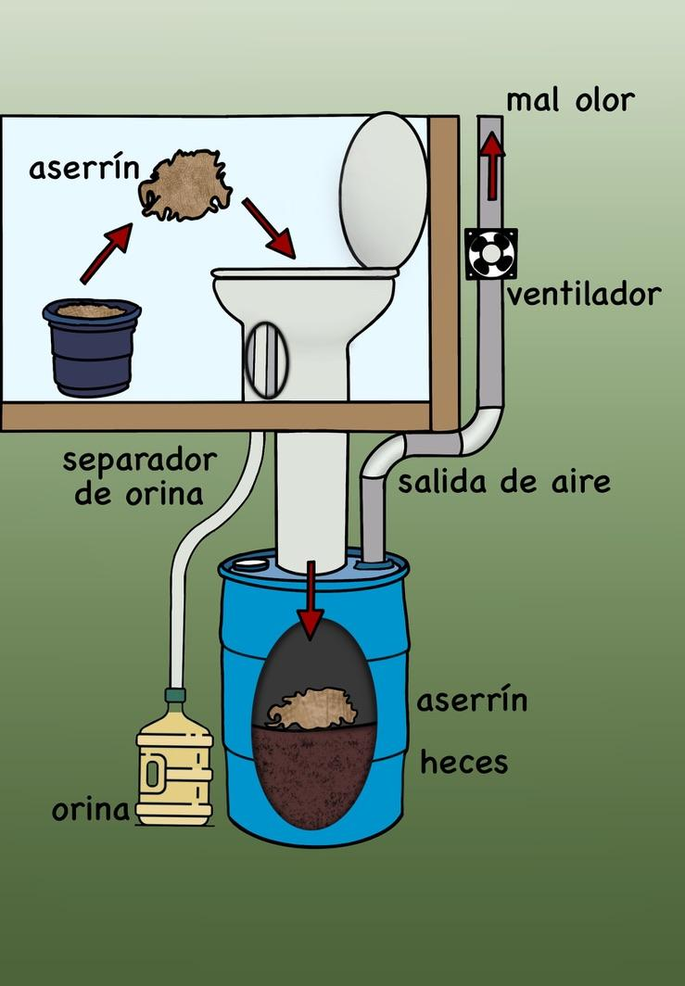
Free-listing and Pile-sorting (N=15)
People’s perceptions on eco-toilets/composting toilets
Average Duration
13 minutes

Slide 20
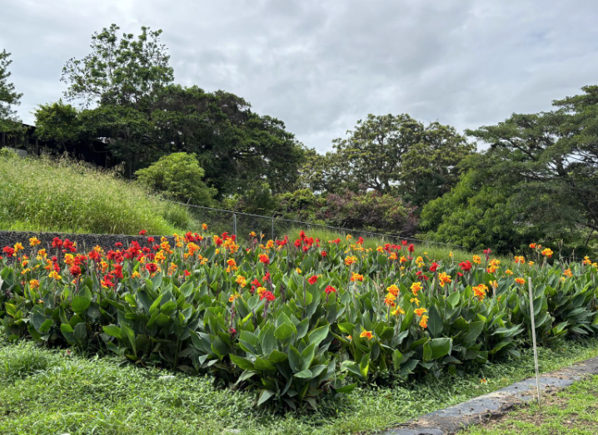
Y2 (2025): “Gray Water” Constructed Wetlands (Bio-gardens)

Slide 21
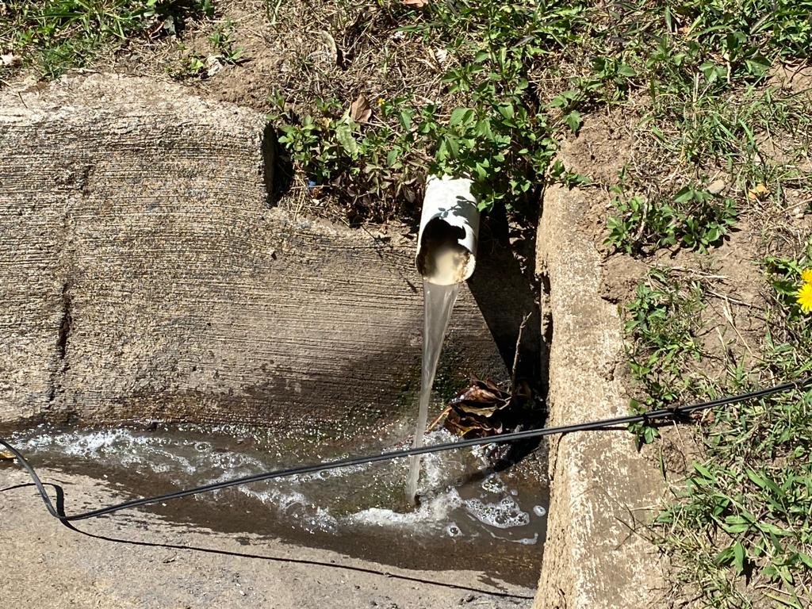
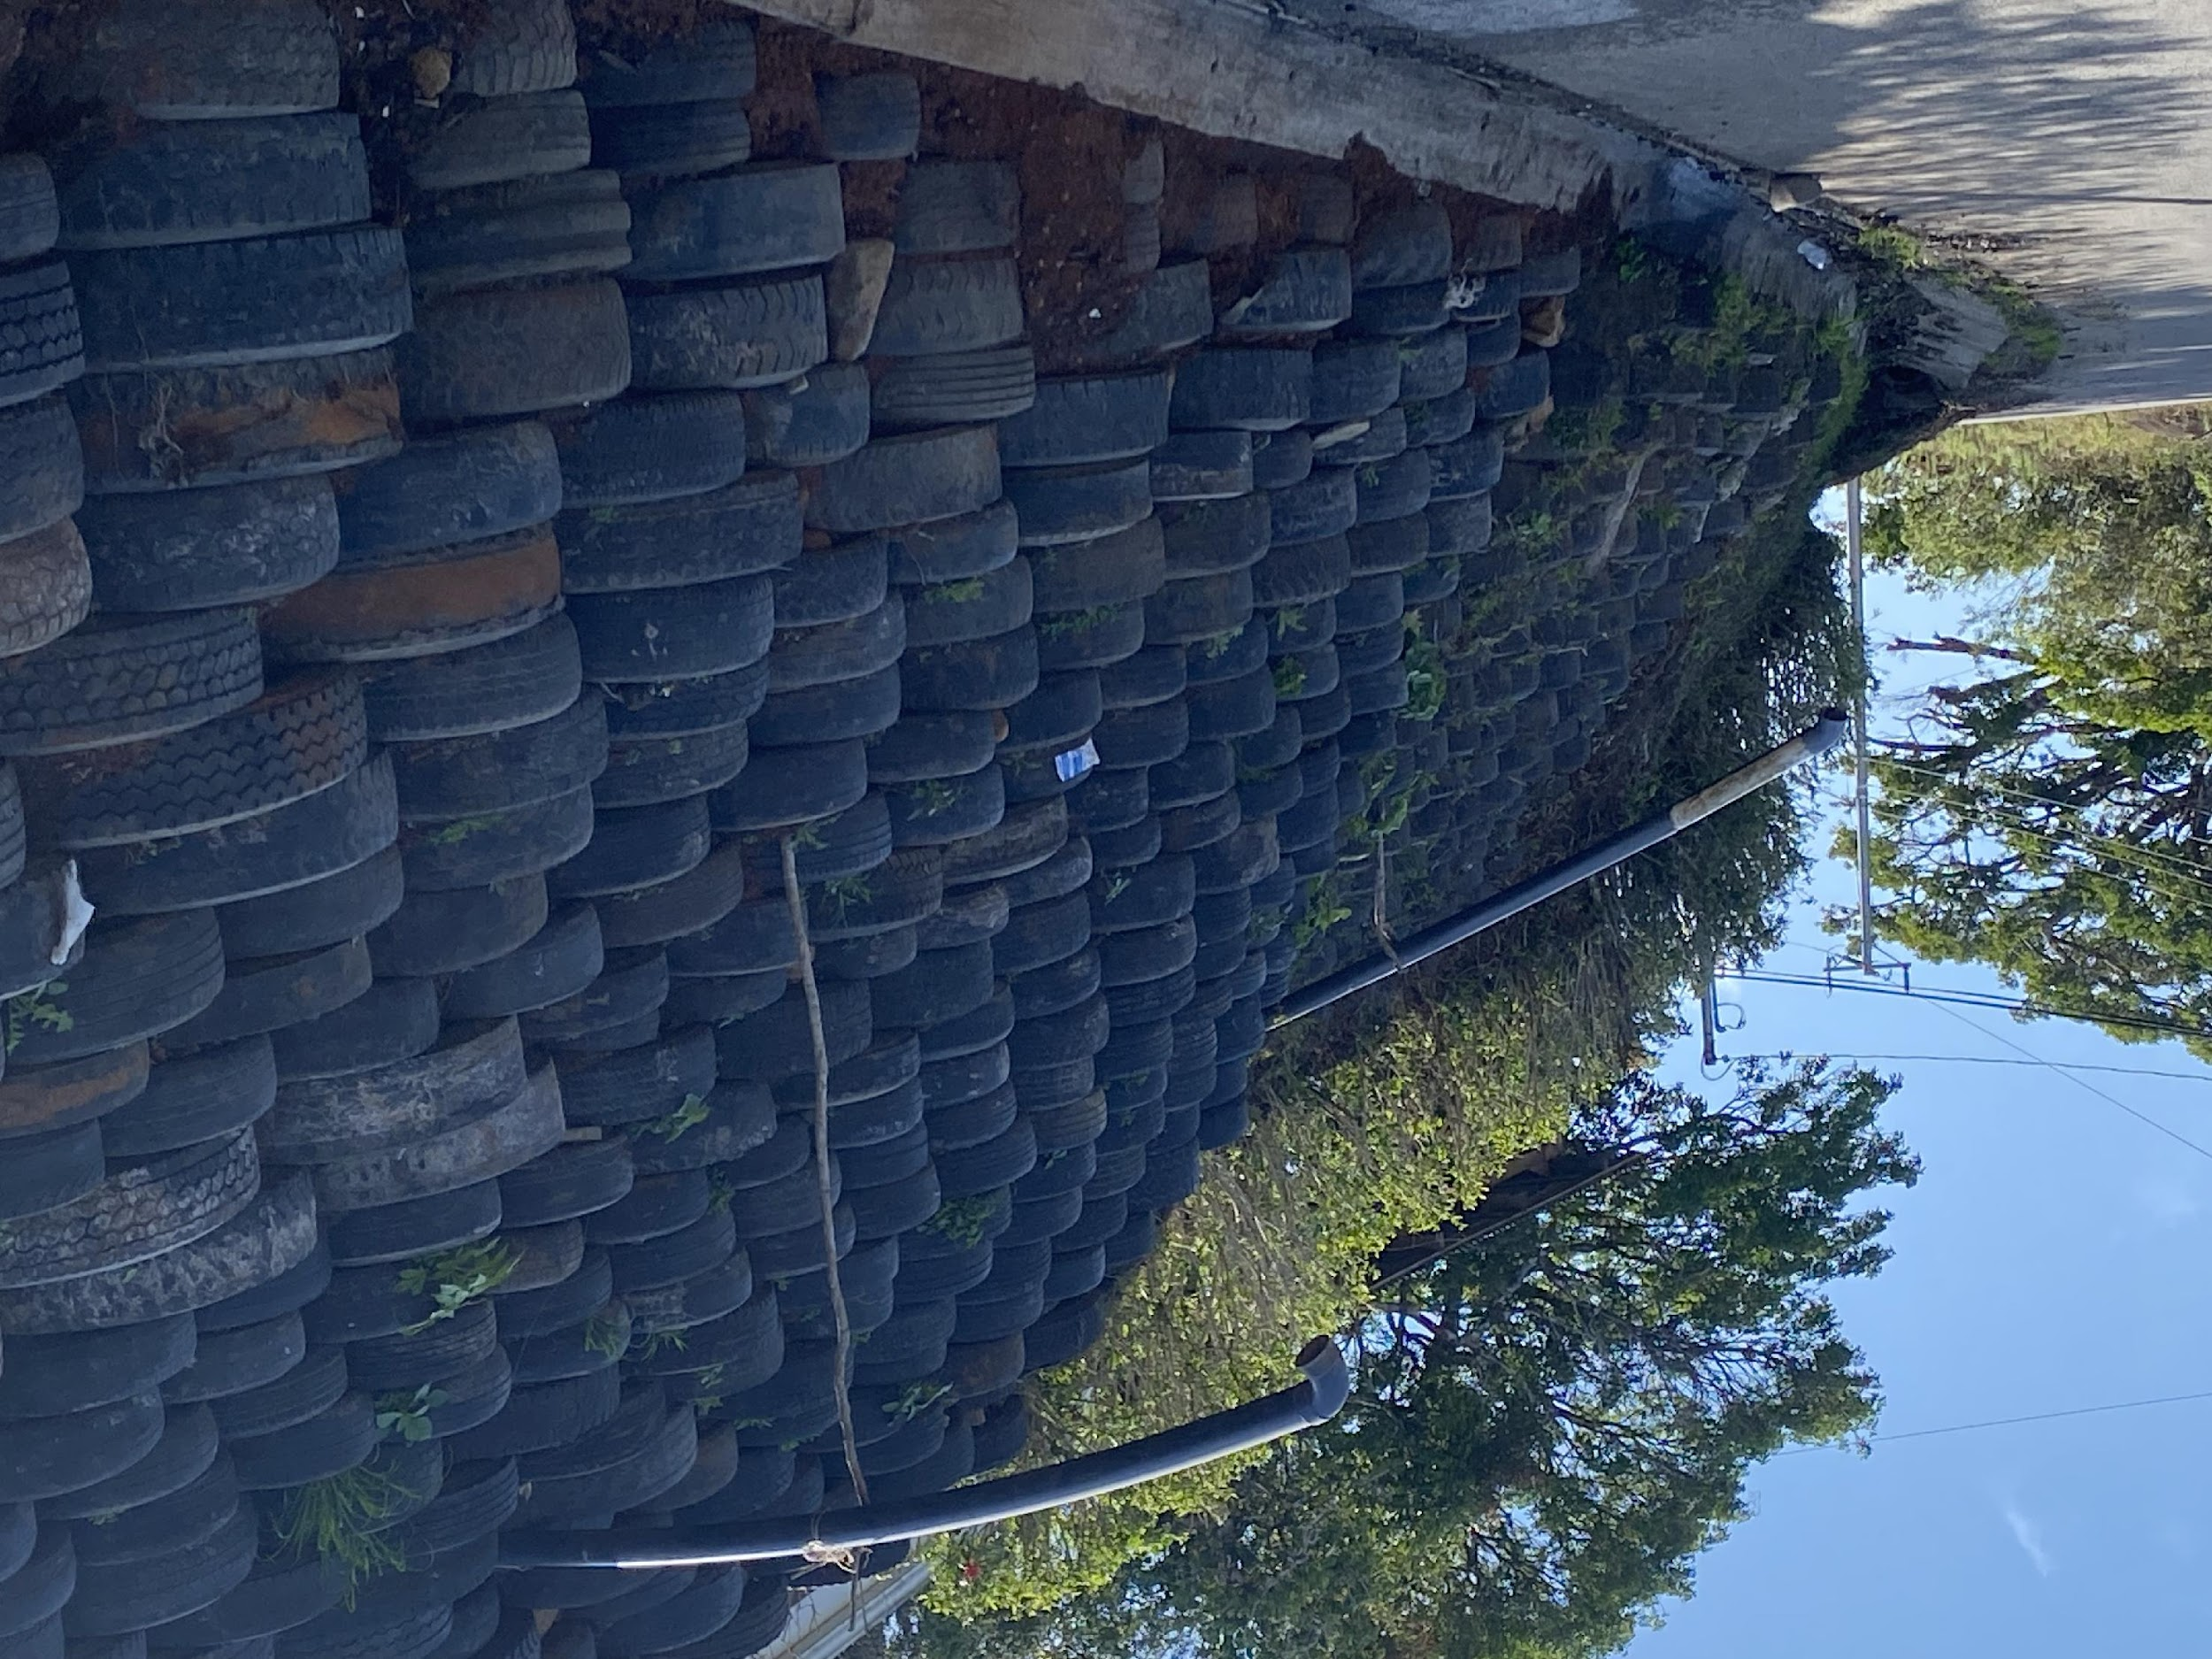
Current Greywater Management
Contamination of surface waters
Direct discharge to streets or groundwater
Untreated greywater, aesthetic issues
Greywater often goes untreated into the street
Greywater effluent discharging into the street

Slide 22
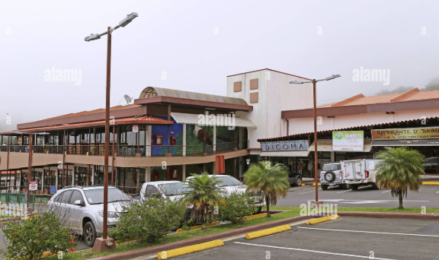
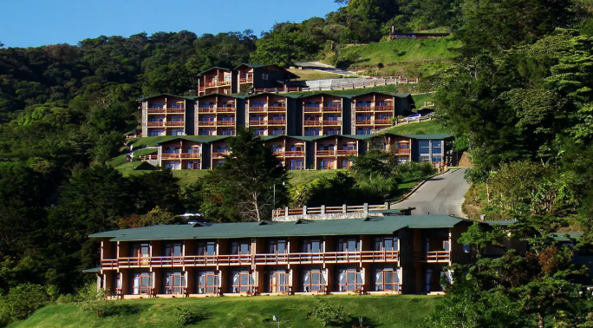
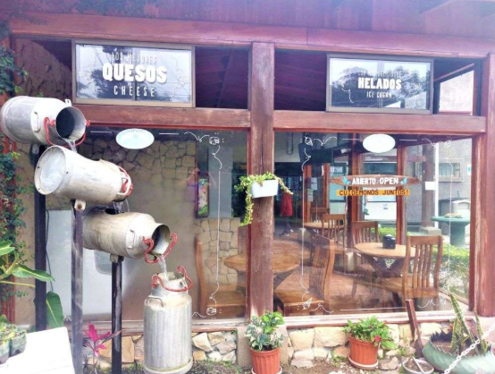
Y3 (2026): Institutional-Level Systems (hotels, industry, commerce)

Slide 23
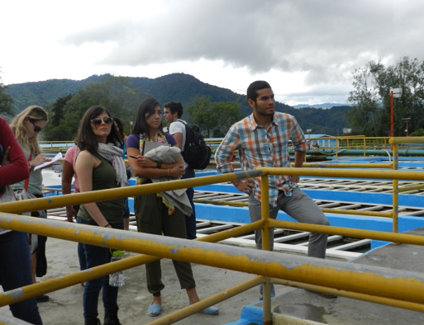
What students will do
Days 1 and 2 (San Jose): tour of wastewater treatment plant, interact with UCR faculty and students
Days 3-10 (Monteverde w/ faculty): Orientations, trainings, site visits
Days 11-42 (Monteverde w/ local advisors): Environmental sampling and analyses, surveys, and focus groups
In Monteverde, live with a host family. (breakfast and dinner with family, packed lunch).

Slide 24
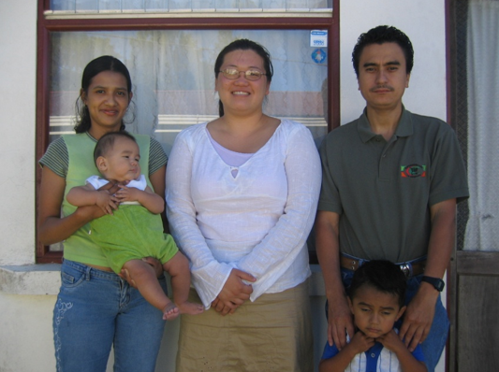
Typical Day
7:30am Breakfast w/ host family
9:00-12 Anthropology or
Engineering Training at MVI
12-1 Lunch
1-4 Anthropology or Engineering Field Work
4-4:30 Debrief
5:30pm Dinner w/host family

Slide 25
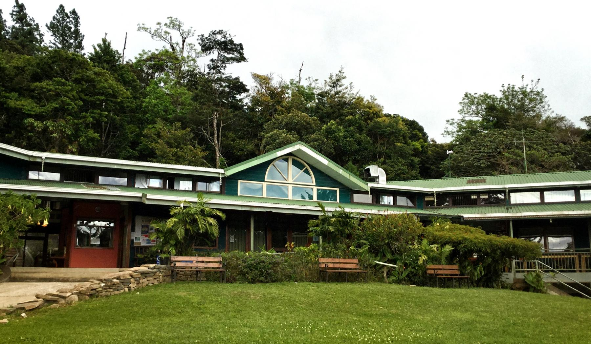

MONTEVERDE INSTITUTE
Our mission is to promote social, ecological and economic sustainability by integrating community initiatives with education, research and conservation.
Notes:
Fern: We are a Costa Rican non-profit association with public service designation - granted because all revenue generated by our academic programs is reinvested in our Center for Community Initiatives.

Slide 26
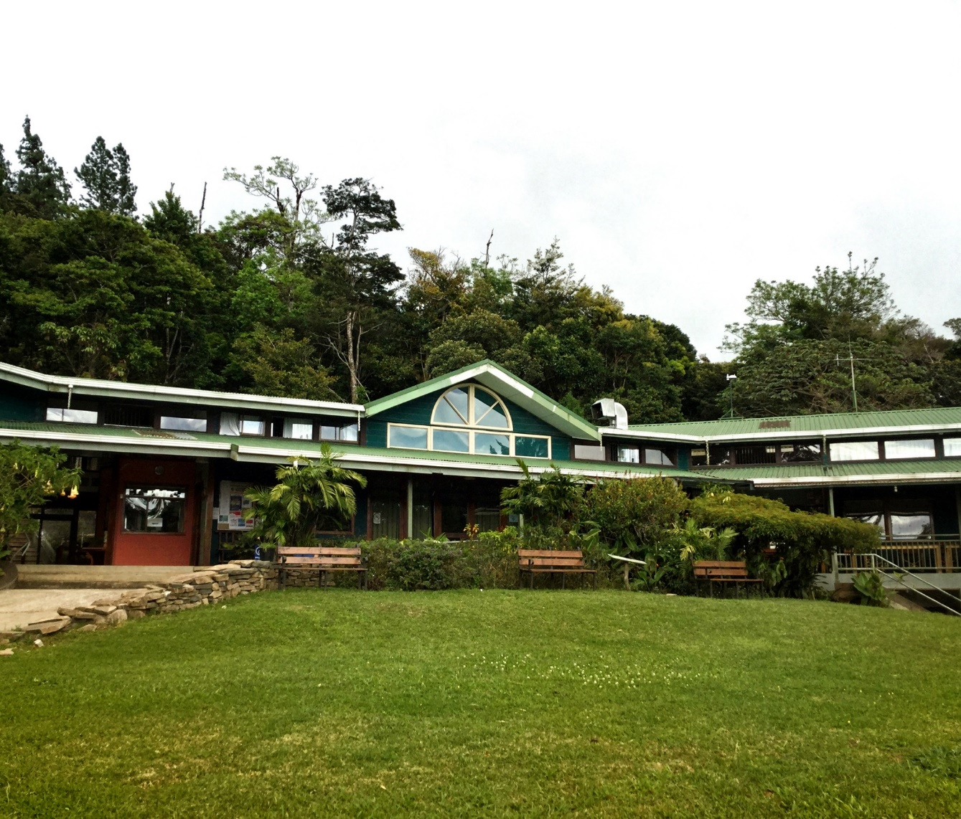
The Monteverde Institute Model
ACADEMIC PROGRAMS
Place-based education with more than 30 collaborating universities that includes research and service to the community
Three pillars: place-based education, applied research, and community programs.
RESEARCH
COMMUNITY INITIATIVES
Notes:
Fern: The MVI stands on three pillars: place-based education, applied research, and community programs. These three areas are integrated, interact and support each other. The MVI accomplishes this goal by integrating academic programs, research, and community initiatives into dynamic programs. For example:

Slide 27
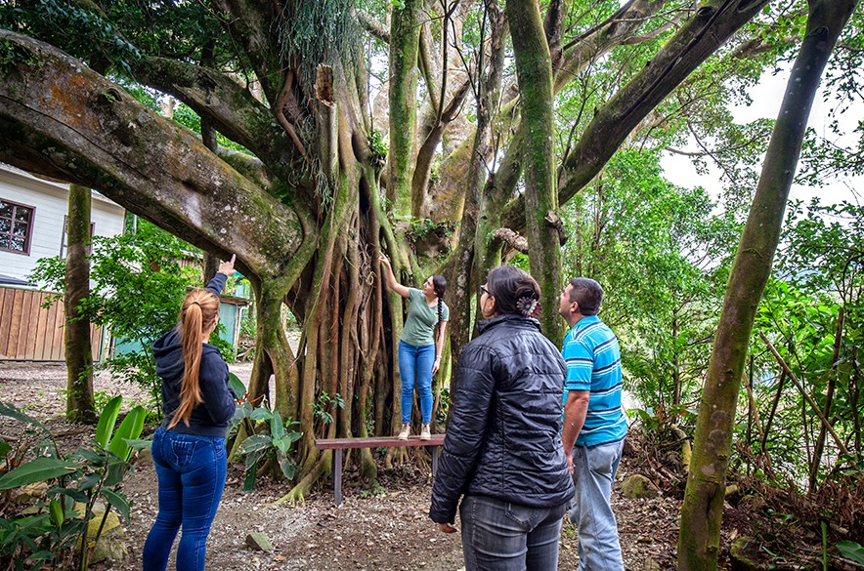
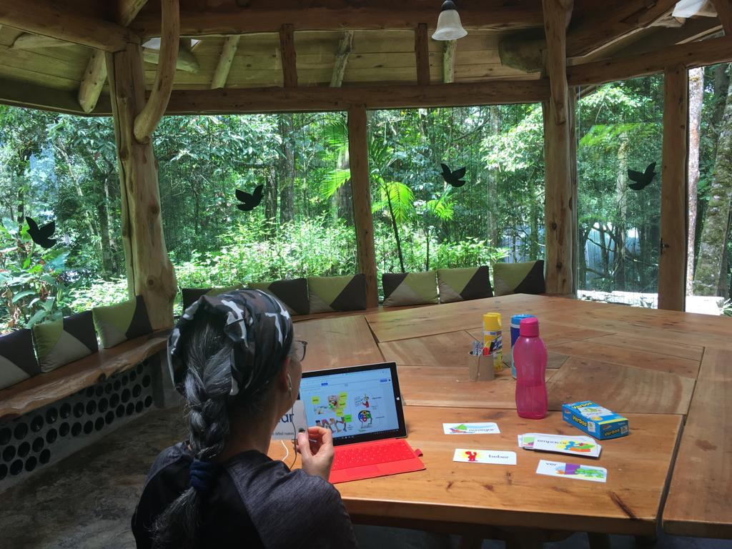
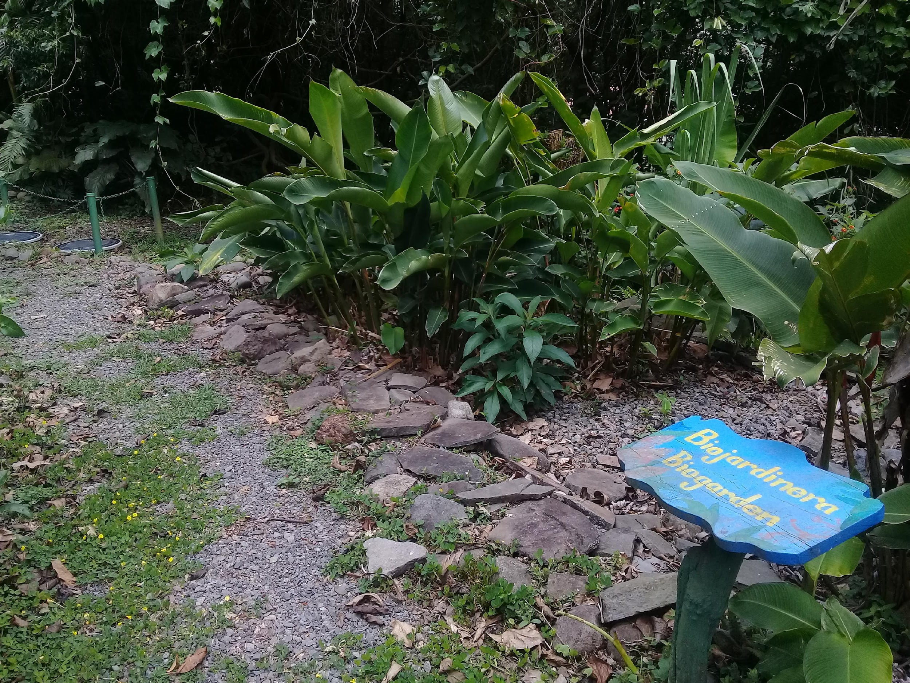
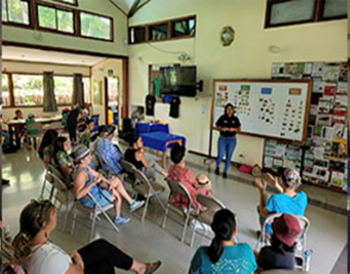
Monteverde Institute Orientation
Facilities orientation
Introductory presentation to Monteverde and campus tour
Classes
Notes:
Fern: Upon arrival to Monteverde, you will be welcomed to MVI with an open house, facilities orientation, and presentation providing local context and the MVI story. The MVI campus will be one of your homes-away-from home while in Monteverde, and where you receive your classes.

Slide 28

Health & Safety
Health and safety are shared responsibilities, self-care and group awareness are important
More orientation when you arrive
Consider site-specific risks and contingency plans throughout the program
WFR-certified program staff and MVI emergency response team
911 service
https://www.pngegg.com/en/png-iexnd
Notes:
Fern: You will receive more health and safety orientation upon arrival
Be prepared – carry with you water, rain gear, sun protection, flashlight, first aid kit, emergency contacts, etc. Be aware of your belongings. Don’t carry any ítems of value when not necessary.
Carry a copy of your Passport with you (photo and entry stamp pages); leave the original in a secure place. Program staff and MVI emergency response team are here for you! Keep emergency contact numbers with you at all times. 911 service available in Costa Rica. Understand the contingency plan and site-specific considerations at each site you visit. Take care of yourself, look out for each other, eat well, stay hydrated, and include consideration that you are in a foreign environment and part of a group program when evaluating risk.

Slide 29
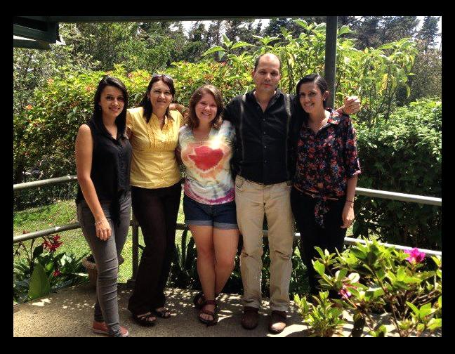
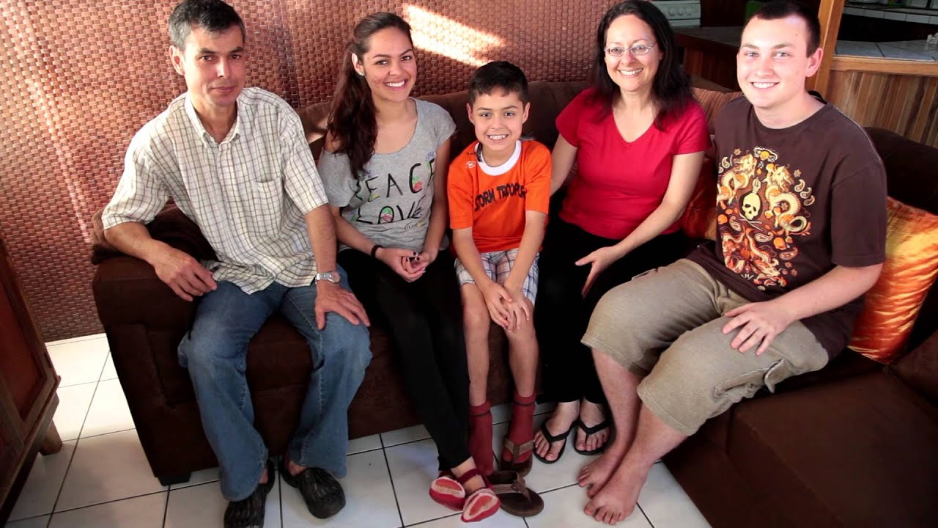

Homestays
An integral part of the program since MVI academic programs began (1987)
Community connections and local context
Cultural immersion
Spanish
Notes:
Ale: Our homestay program has been an integral part of MVI since the beginning in 1987 – 36 six years experience working on this program. This is a great opportunity for students to experience a real cultural immersion and an opportunity to practice your Spanish. We have a homestay coordinator onsite: Karen. She gives a homestay orientation before going to the host families with regular check-ins, and she gives support if needed while you are in homestay…you will have support from us.

Slide 30



Food
Rice and beans
Many carbs, minimal animal protein
Gallo pinto for breakfast
Casado for lunch/dinner
Fruits and vegetables
Overall vegetarian/vegan-friendly, dietary restrictions accommodated
All meals included in program cost
Notes:
Ale: Rice and beans are staple to the Costa Rican diet. Gallo pinto is a common breakfast dish combining rice and beans. A casado is rice, beans, a protein (could be beef, chicken, fish), vegetable hash, salad, and might include fried sweet plantains. In addition to the tropical fruits and vegetables you might already know, you’ll likely try some new ones. Allergies and dietary restrictions are accommated–We will send forms to you in order to accomodate your restrictions if you have any. Three daily meals are included in the program cost.

Slide 31



Transportation in Monteverde
Sidewalks
Local public bus and taxi service
Plenty of walking
Notes:
Ale: The main road travels from Santa Elena downtown, through Cerro Plano and Monteverde, and past the turn-off for San Luis before ending at the Monteverde Cloud Forest Preserve.
There are Sidewalks almost everywhere in the área, but in some parts there are none. So, please use the sidewalks, but if you have to walk on the road, walk carefully, and defensively and always carry a flashlight when walking at dusk or in the dark.
There is a local public bus service, with limited schedule. When you are here, you can check the Schedule at the reception or with the program coordinator. Official taxis are available from 5:30 am to 10:00 pm., but mostly you will walk between MVI and homestaySome transfers could be included in Monteverde

Slide 32


Professional development goals
Develop global and interdisciplinary skills and competencies through cross-training and multidisciplinary field work
Increase the number of U.S. students from underrepresented groups participating in international research experiences that combine STEM and Social Sciences
Strengthen and expand the partnership between Costa Rican stakeholders and U.S. institutions

Slide 33
Acknowledgement
This material is based upon work supported by the National Science Foundation under Grant No. 2246348. Any opinions, findings, and conclusions or recommendations expressed in this material are those of the author(s) and do not necessarily reflect the views of the National Science Foundation.

Slide 34

A six-week experience in Monteverde, Costa Rica supported by the National Science Foundation International Research Experience for Students Highlights: -Make a difference through interdisciplinary water and sanitation research -Experience the natural beauty of Monteverde’s Cloud Forest -Live with a Costa Rican host family to integrate cultural and academic opportunities Logistics: -All expenses covered by NSF -Receive a $530/week stipend for six weeks in Costa Rica -Pre-travel virtual orientation -Tentative travel dates: June 15 – July 26, 2026 -Preference for applicants with Spanish language skills.
US-Costa Rica Collaboration to Quantify the Holistic Benefits of Resource Recovery in Small-Scale Communities
NSF Grant #: 2246348, 2246349, & 2246350
Scan for More Info
Info Session: Wednesday, November 19th
4pm ET / 1pm PT on Zoom
Apply and find more info at this link:
https://kevinorner.faculty.wvu.edu/costa-rica
Questions to kevin.orner@mail.wvu.edu

